Slide 1
Notification & Work Manager
Week 12 1604C062 Advanced Native Mobile Programming
Teknik Informatika
Universitas Surabaya

Slide 2
Android Notification
Already explained in Week 7
This time combined with WorkManager to create “scheduled notification”
Notification should appear even the app is not active
On latest Android, notification channel is mandatory

Slide 3
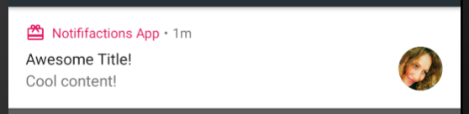
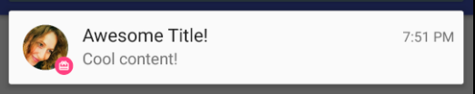
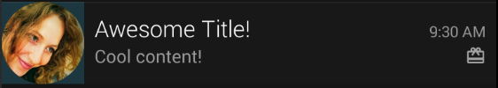
Notification Styles - Basic

Slide 4
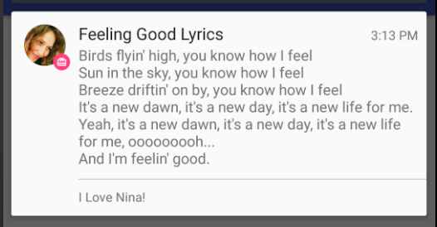
Notification Styles - Big Text

Slide 5
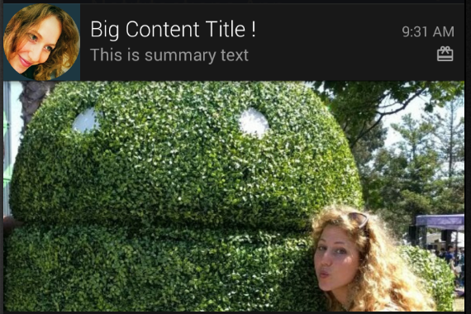
Notification Styles - Big Picture

Slide 6
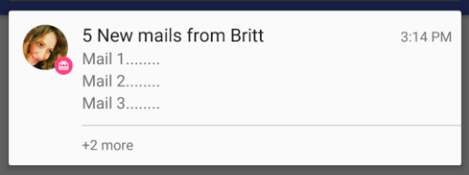
Notification Styles - Inbox

Slide 7
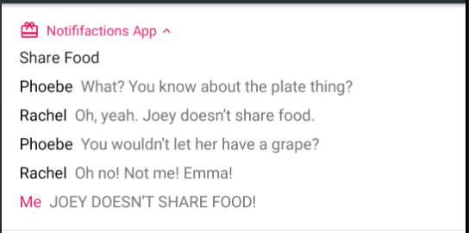
Notification Styles - Messaging

Slide 8
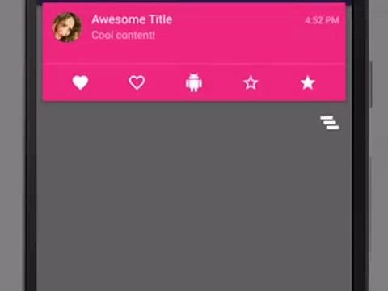
Notification Styles - Media

Slide 9
Push vs Scheduled Notifications
A message that pops up on user devices
Usually triggered by app publisher in certain condition
Scheduled Notification is the pop-up message that have been planned on the background process and delivered at a particular time

Slide 10
Work Manager
WorkManager is an API that makes it easy to schedule some tasks that are expected to run even if the app exits or the device restarts.
To enable WorkManager, add the following dependency (version number may change)
implementation "androidx.work:work-runtime-ktx:2.7.1"

Slide 11
Worker Class
doWork
The doWork() method runs asynchronously on a background thread provided by WorkManager.
class UploadWorker(appContext: Context, workerParams: WorkerParameters):
Worker(appContext, workerParams) {
override fun doWork(): Result {
// Do the work here--in this case, upload the images.
uploadImages()
// Indicate whether the work finished successfully with the Result
return Result.success()
}
}
Result
The possible result outcomes are: Success, Failure, and Retry

Slide 12
Work Request
The WorkRequest object contains all of the information needed by WorkManager to schedule and run your work
There are two derived implementations of this class that you can use to create the request: OneTimeWorkRequest and PeriodicWorkRequest

Slide 13
Example of OneTimeWorkRequest
val uploadWorkRequest: WorkRequest =
OneTimeWorkRequestBuilder<MyWork>()
// Additional configuration
.build()
MyWork
This is a worker object

Slide 14
Example of PeriodicWorkRequest
val saveRequest =
PeriodicWorkRequestBuilder<SaveImageToFileWorker>(1, TimeUnit.HOURS)
// Additional configuration
.build()
MyWork
This is a worker object

Slide 15
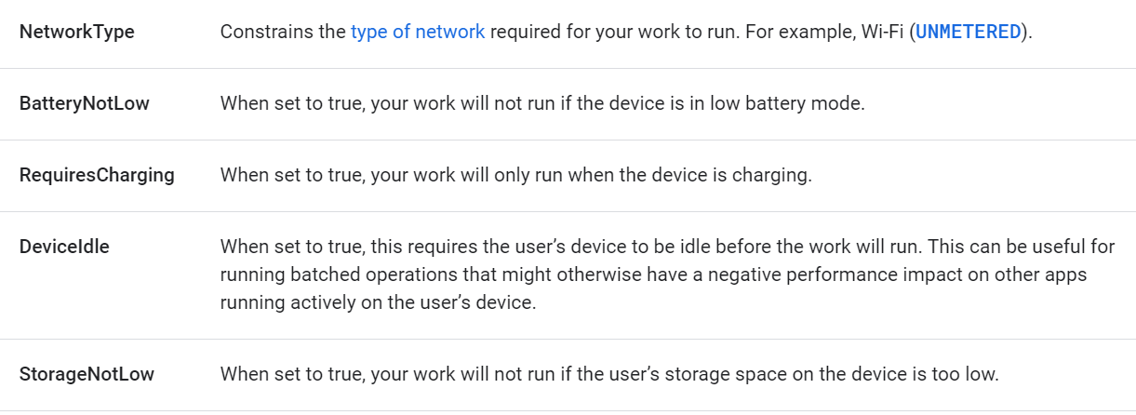
Work Constraints
Constraints ensure that work is deferred until optimal conditions are met

Slide 16
Work Constraint
val constraints = Constraints.Builder()
.setRequiredNetworkType(NetworkType.UNMETERED)
.setRequiresCharging(true)
.build()
val myWorkRequest: WorkRequest =
OneTimeWorkRequestBuilder<MyWork>()
.setConstraints(constraints)
.build()

Slide 17
Delayed Work
If you do not want the work to be run immediately, you can specify your work to start after a minimum initial delay.
val myWorkRequest = OneTimeWorkRequestBuilder<MyWork>()
.setInitialDelay(10, TimeUnit.MINUTES)
.build()

Slide 18
Assign Input Data
Your work may require input data in order to do its work. For example, work that handles uploading an image might require the URI of the image to be uploaded as input.

Slide 19
Assign Input Data
// Define the Worker requiring input
class UploadWork(appContext: Context, workerParams: WorkerParameters)
: Worker(appContext, workerParams) {
override fun doWork(): Result {
val imageUriInput =
inputData.getString("IMAGE_URI") ?: return Result.failure()
uploadFile(imageUriInput)
return Result.success()
}
Key-Value Pair
Input Data works as same as key-value pair

Slide 20
Assign Input Data
// Create a WorkRequest for your Worker and sending it input
val myUploadWork = OneTimeWorkRequestBuilder<UploadWork>()
.setInputData(workDataOf(
"IMAGE_URI" to "http://..."
))
.build()
key
value

Slide 21
Enqueue Work
Once you’ve defined your Worker and your WorkRequest, the last step is to enqueue your work.
The simplest way to enqueue work is to call the WorkManager enqueue() method, passing the WorkRequest you want to run.

Slide 22
Enqueue Work
val myWork: WorkRequest = ... // OneTime or PeriodicWork
WorkManager.getInstance(requireContext()).enqueue(myWork)

Slide 23
Cancelling Work
If you no longer need your previously enqueued work to run, you can ask for it to be cancelled.
workManager.cancelWorkById(syncWorker.id)
workManager.cancelUniqueWork("sync")
workManager.cancelAllWorkByTag("syncTag")

Slide 24
Self Study Materials
Work retry and backoff policy
Observe work
Work Chaining
etc

Slide 25
Exercise
Todo Notification
This following exercise uses project from Week8 (Todo)

Slide 26
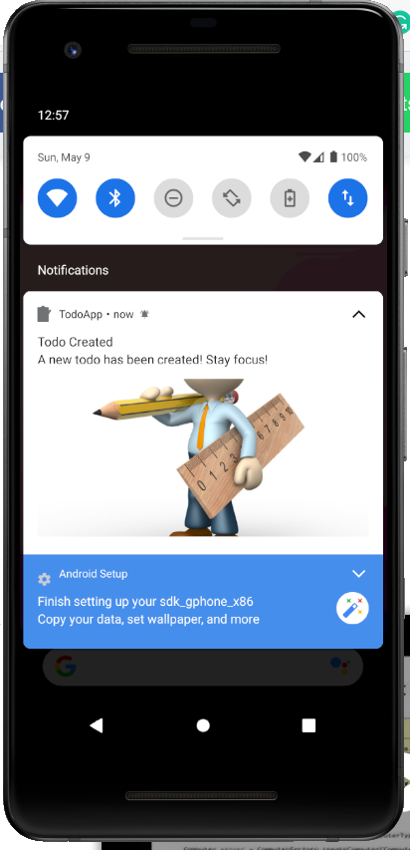
1.
Notification Helper
Create helper class that provide modular and practical object to create a notification

Slide 27
Notification Helper
Right click on Util package, new > kotlin class
Choose class
Name it as “NotificationHelper”
Create two variable: Channel and Notif ID
class NotificationHelper(val context: Context) {
private val CHANNEL_ID = "todo_channel_id"
private val NOTIFICATION_ID = 1
}
Context
Context is used to create pending intent later

Slide 28


Import Icon
Download two files from ULS, todochar.jpg and checklist.png
Copy paste both files (twice. One for v24 other for normal version) to Drawable (res)

Slide 29
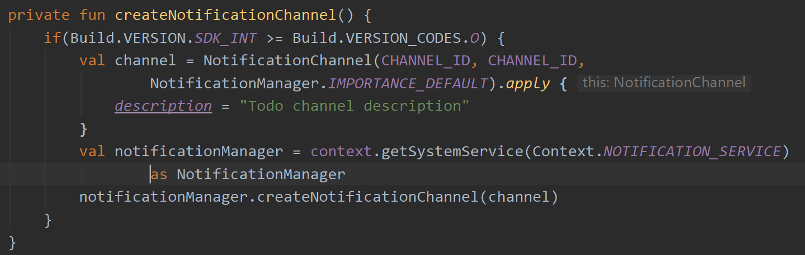
Notif Channel
Checking OS Version
Oreo above requires notification channel. Check it first here

Slide 30
Create Notif
FLAG_ACTIVITY_NEW_TASK
If set, this activity will become the start of a new task on this history stack.
FLAG_ACTIVITY_CLEAR_TASK
This flag will cause any existing tasks that would be associated with the activity to be cleared before the activity is started.
fun createNotification( title:String, message:String) {
createNotificationChannel()
val intent = Intent(context, MainActivity::class.java).apply {
flags = Intent.FLAG_ACTIVITY_NEW_TASK or Intent.FLAG_ACTIVITY_CLEAR_TASK
}
val pendingIntent = PendingIntent.getActivity(context,0, intent, 0) }
Pending Intent
Context, request code, intent object, flag

Slide 31
Pending Intent
A PendingIntent is a token that you give to a foreign application (e.g. NotificationManager, AlarmManager, Home Screen AppWidgetManager, or other 3rd party applications)
It allows those apps to use your permissions to execute a predefined piece of code.

Slide 32
Create Notif
ICON
This icon object is used for BigStyle notification.
. . .
val pendingIntent = PendingIntent.getActivity(context,0, intent, 0)
val icon = BitmapFactory.decodeResource(context.resources, R.drawable.todochar)
val notification = NotificationCompat.Builder(context, CHANNEL_ID)
.setSmallIcon(R.drawable.checklist)
.setLargeIcon(icon)
.setContentTitle(title)
.setContentText(message)

Slide 33
Create Notif
BIG STYLE
Setup big style notifications, provide big picture and also (optional) the big large icon.
.setStyle(
NotificationCompat.BigPictureStyle()
.bigPicture(icon)
.bigLargeIcon(null)
)
.setContentIntent(pendingIntent)
.setPriority(NotificationCompat.PRIORITY_DEFAULT)
.build() NotificationManagerCompat.from(context) .notify(NOTIFICATION_ID,notification)
Pending Intent
It allows notification to be clicked and trigger the pending intent (invoke app Main Activity)

Slide 34
Try in Create Todo
Add following codes in Create Todo Button Listener (CreateTodoFragment.kt)
NotificationHelper(view.context)
.createNotification("Todo Created",
"A new todo has been created! Stay focus!")

Slide 35
WorkManager
The next goal is to create a delayed notification even the app is no longer active
In that case, it requires WorkManager API
Open the gradle and add following dependency (adjust the version number as needed):
implementation "androidx.work:work-runtime-ktx:2.7.1"
Dont forget to sync now

Slide 36
Worker Class
Right click on the Util package > new > Kotlin class
Set name as “TodoWorker”, set kind as “class”

Slide 37
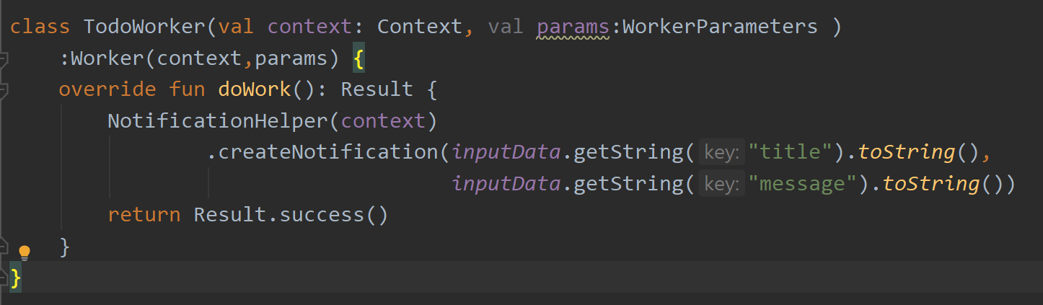
Worker Class
doWork
This class have a Asynchronous function doWork() that trigger the creation of notification
inputData
This is a key-value object that contain information to be processed within the doWork()

Slide 38
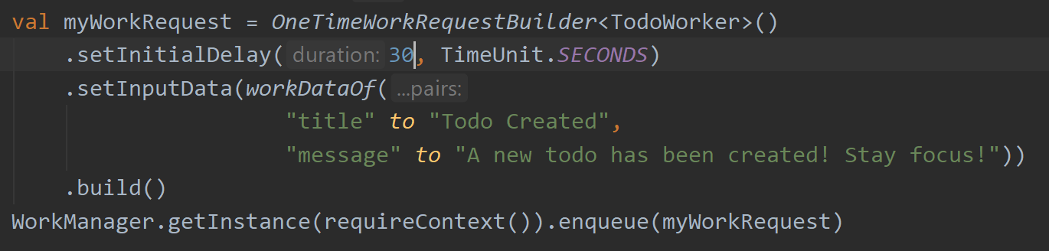
Delay Work Request
Open the Create todo Button Listener, add following code

Slide 39
Delay Work Request
Delay
One time request setting up the delay of 30 seconds. This means the notification will show 30 seconds later after work queued

Slide 40
Delay Work Request
Key-Value Pair
This is a InputData object thar constructed from the key and value pair. Left part is the key, and the the right part after “to” is the value

Slide 41
Delay Work Request
Enqueue
This is where the work request is being queued. It will be registered on the android system and 30 seconds later will launch the notification.

Slide 42
Run The Project
Create a new Todo. Close the app. Wait 30 seconds.
Do you see the notification?

Slide 43
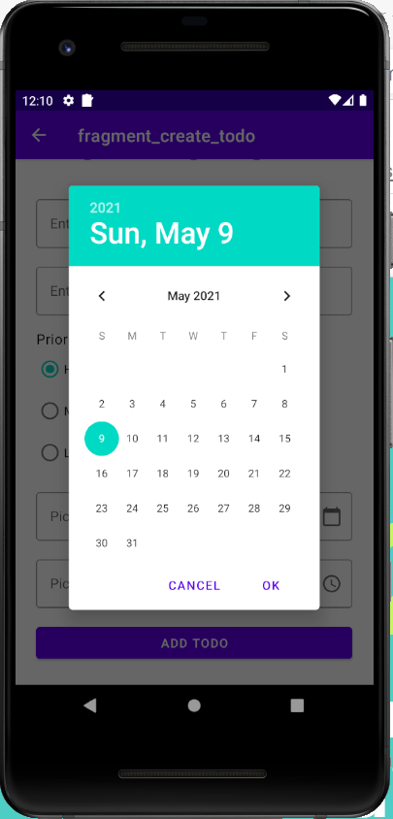
2.
Scheduled Notification
A Notification that triggered on particular date & time

Slide 44
The Problem
Work manager can’t handle specific work request date and time
It can only count delays in time unit. Example: setInitialDelay(30, TimeUnit.SECONDS)
The alternative solution is to use another API called AlarmManager

Slide 45
Proposed Solution
In order to create a scheduled notification that only utilize WorkManager:
First convert the scheduled date time into Unix timestamp
Find differences (in seconds) between the scheduled timestamp and current time
Set delays with that value

Slide 46
3.
Prepare Data Binding
Implement data binding into Create Todo Fragment

Slide 47
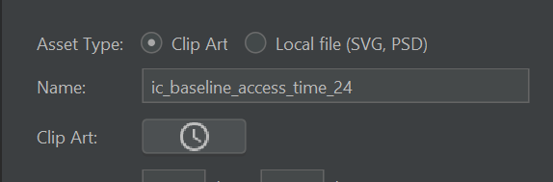
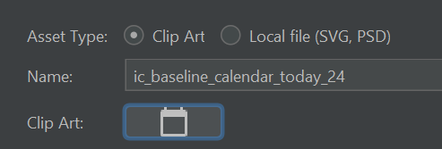
Vector Asset
First, let’s modify the layout
Add two new vector assets:

Slide 48
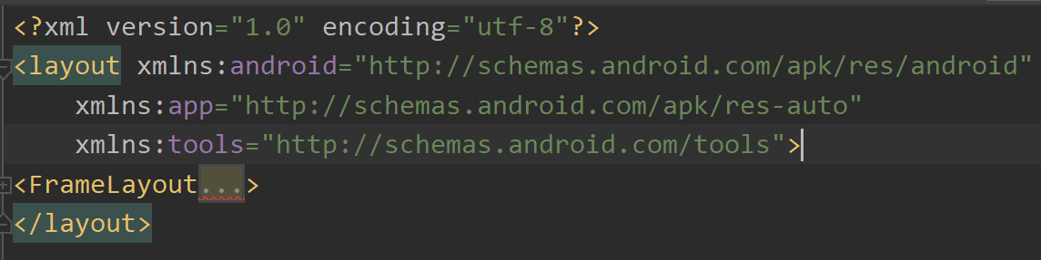
Layout Wrapper
Open the fragment_create_todo.xml
Apply layout wrapper (don’t forget to rebuild)

Slide 49
Layout Variable
Add layout variable of:
todo
radiolistener (copy paste it from edit todo fragment layout)
Create data binding on corresponding view

Slide 50
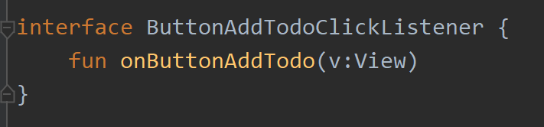
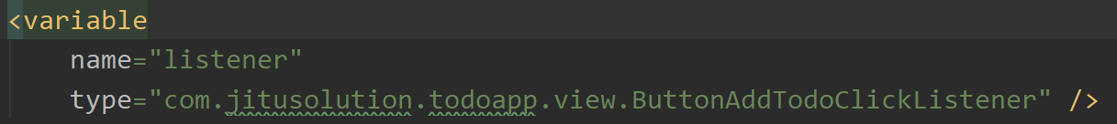
Listener Binding for Button Create
Interfaces.kt
Set variable in layout

Slide 51
Listener Binding for Button Create
Listener Binding android:onClick="@{listener::onButtonAddTodo}"
Implement the ButtonAddTodoClickListener interface on CreateTodoFragmet
Comment the original Button Add Listener

Slide 52
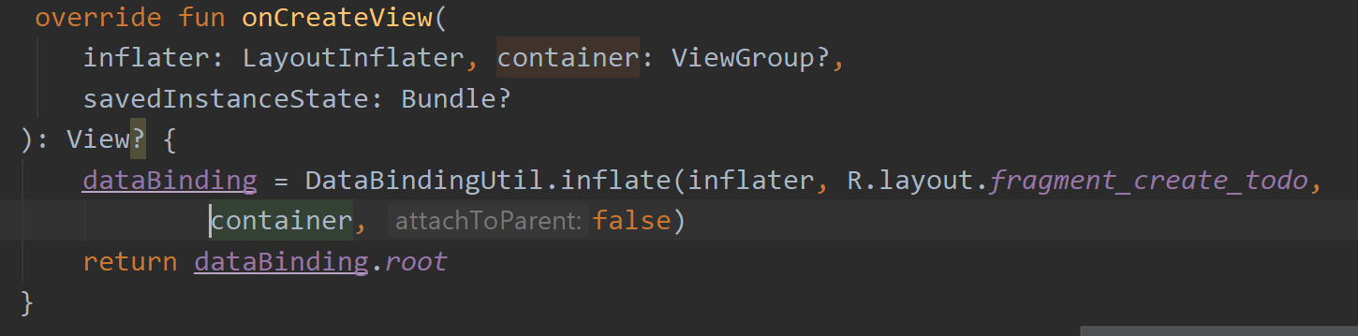
Setting Up Data Binding
Create databinding variable
private lateinit var dataBinding:FragmentCreateTodoBinding
Modify onCreateView

Slide 53
Listener Binding for Button Create
Instantiate the layout variable (onViewCreated)
dataBinding.todo = Todo("","",3,0)
viewModel = ViewModelProvider(this).get(DetailTodoViewModel::class.java)
dataBinding.listener = this
dataBinding.radioListener = this

Slide 54
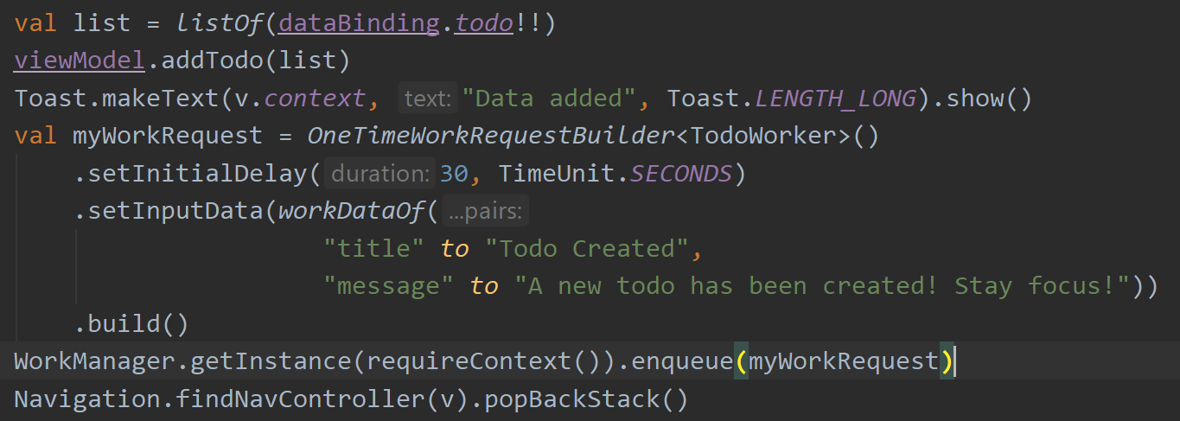
Codes for Button Add Listener
You can use let instead if you are not comfortable with non-null assertion

Slide 55
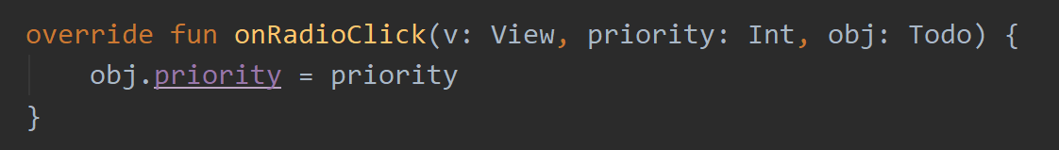
Codes for Radio Listener
Radio Click Listener
class CreateTodoFragment : Fragment(), RadioClick, ButtonAddTodoClickListener
Radio Click Implementation

Slide 56
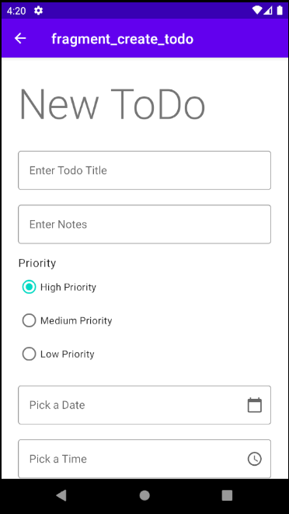
Run The Project
If data binding is configured properly, it should be functional as it was previously

Slide 57
4.
Migration
Add new field “todo_date” into the Todo table

Slide 58
Todo Date Field
The todo data will have a new field which is the date & time of the todo
Unfortunately, SQLite does not have a DATE TIME data type
Therefore, to store this date & time todo, it should use INTEGER instead
UNIX timestamp information that will be stored. Why?

Slide 59
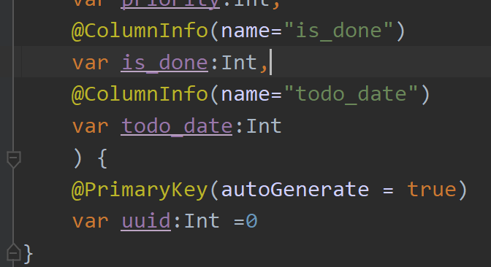
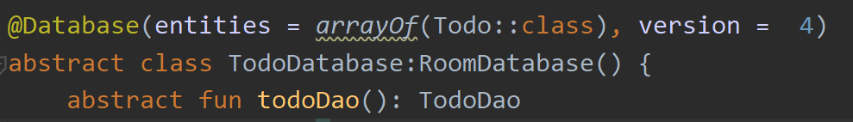
Todo Model & Increase DB Version

Slide 60
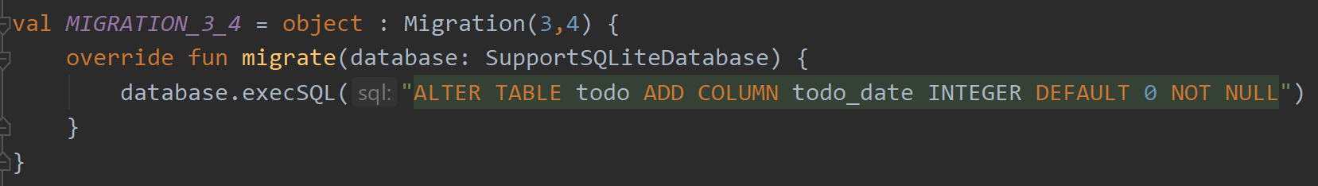
The Migration
Open the Util.kt (add new migration)

Slide 61
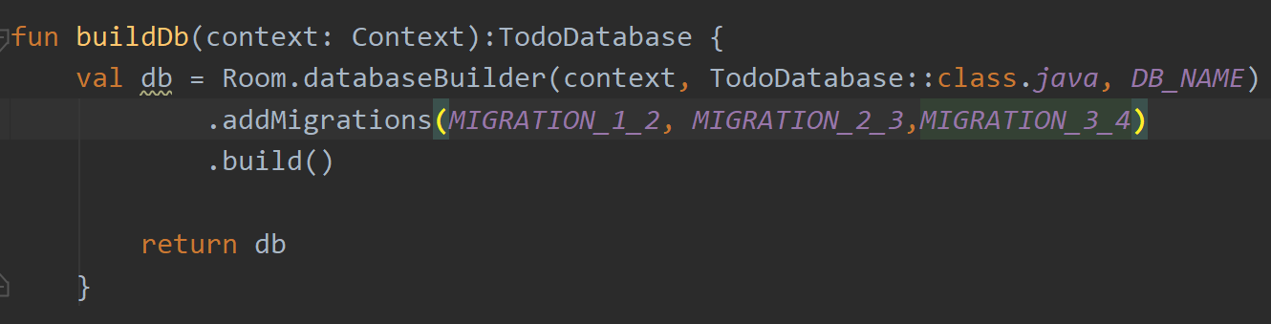
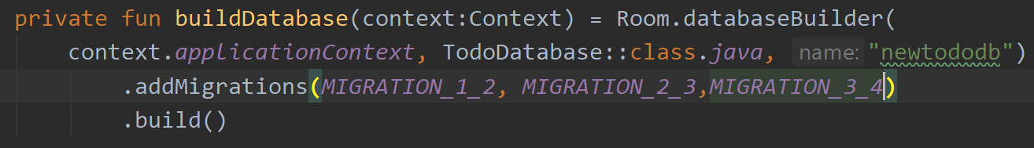
Add the Migration
Util.kt
TodoDatabase.kt

Slide 62
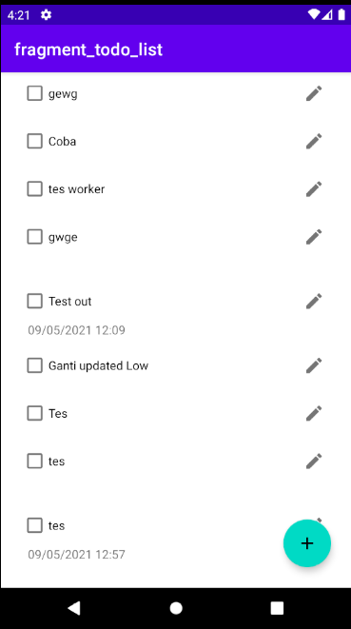
Run The Project
Make sure the migration works fine

Slide 63
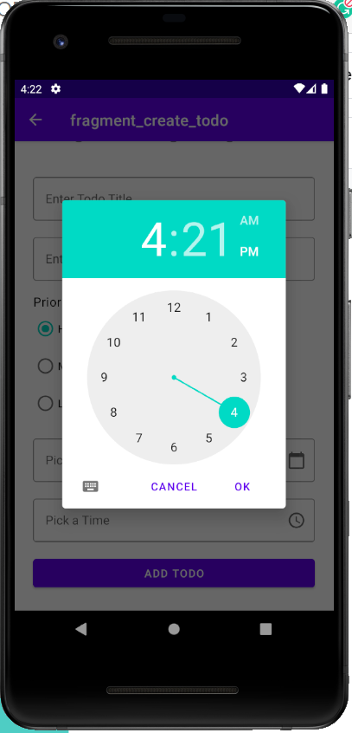
5.
Picker
Prepare Date & Time Picker

Slide 64
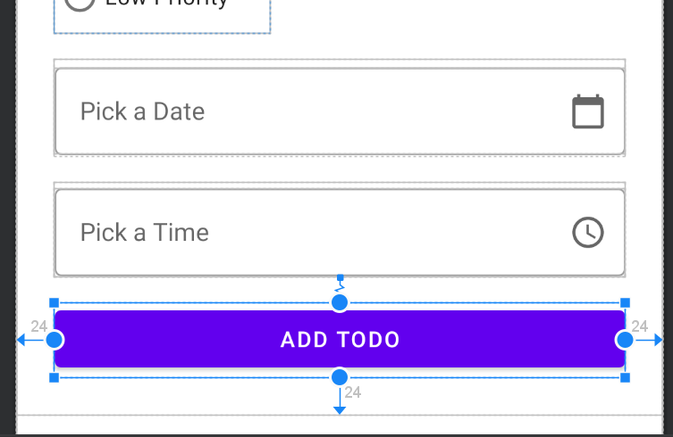
TextInputLayout Time & Date
Open the fragment_create_todo.xml
Add two TextInputLayout (date & time)
EndIcon
endIconDrawable = calendar or time icon
endIconMode = custom
EditText
enabled= true
focusable = false
id = txtDate & txtTime
Add Todo Button
Constrained to the bottom of pick a time input layout

Slide 65
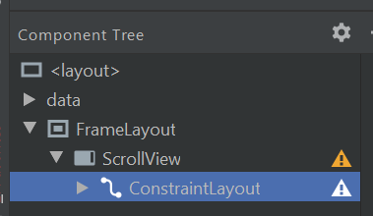
ScrollView
Since the layout contains a lot of items and it makes some of view object rendered beyond the phone screen, it needs the ScrollView
Drag and drop ScrollView make sure it’s structured like screenshot on the right

Slide 66
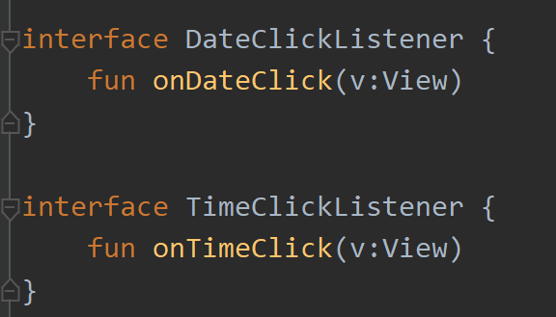
Interface Listener for Time & Date
Open the interfaces.kt
Click Listener
This click listener should be attached to the Edit Text of Time & Date to trigger the dialog picker

Slide 67
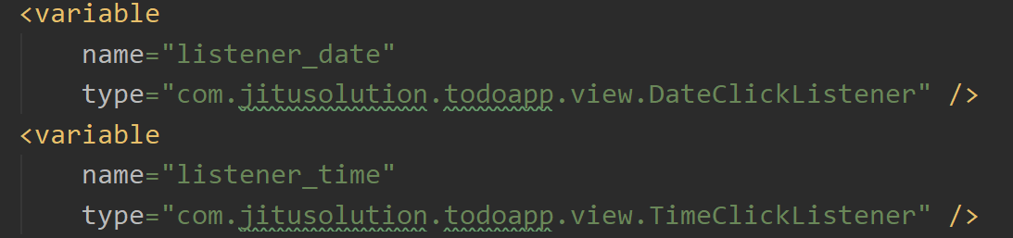
Set Listener on Layout
Create listener variable for both date and time

Slide 68
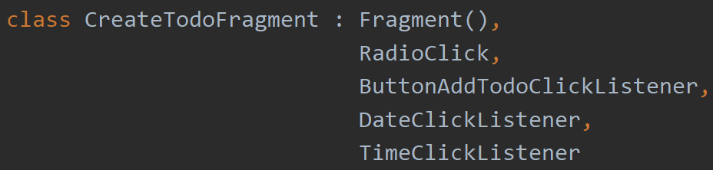
Set Listener on Layout
Set listener to both time & date
Implement the Interface

Slide 69
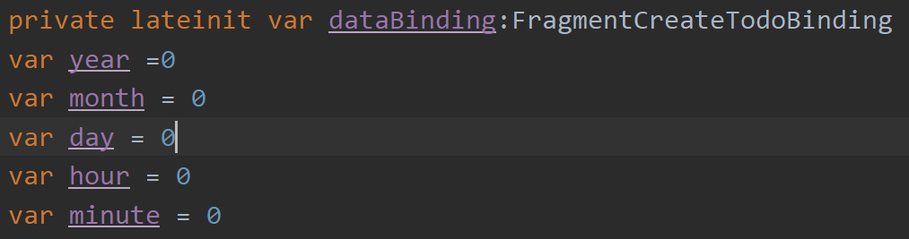
Init Date & Time Variable
These variables should be used to calculate delay differences

Slide 70
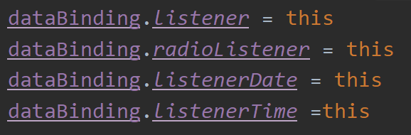
Instantiate The Listener
onViewCreated

Slide 71
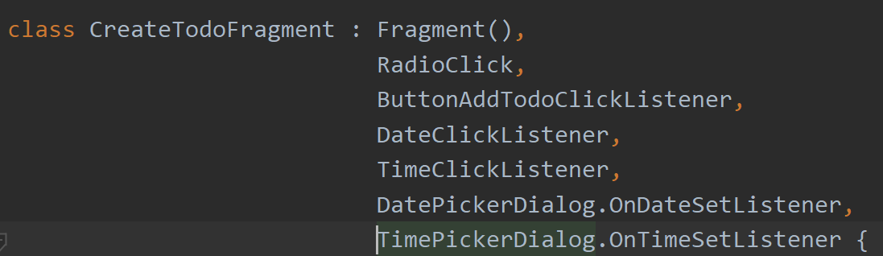
Implement The Picker Listener
Both listener is required to handle the picker result

Slide 72
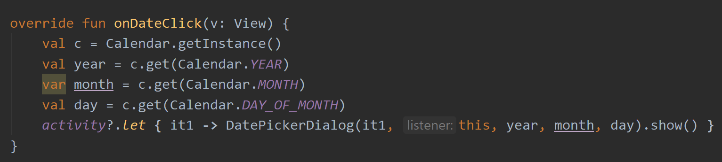
Trigger Time & Date Picker
Add following codes into onDateClick

Slide 73
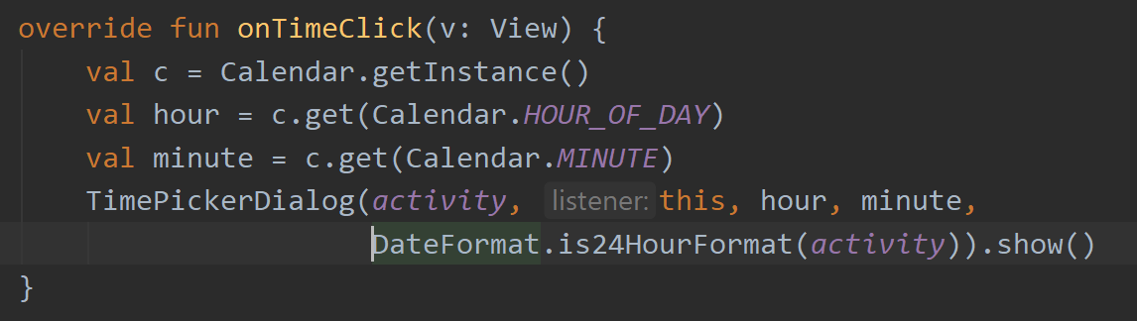
Trigger Time & Date Picker
Add following codes into onTimeClick

Slide 74
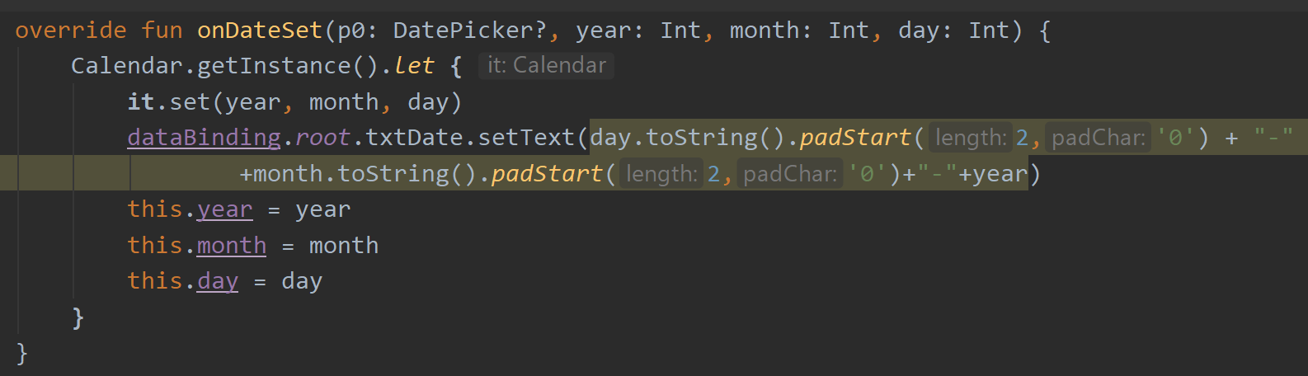
Handle Picker Result
padStart
This String function useful to add leading zero in a String. Ex: 0001
Add following codes into onDateSet
txtDate
Date picked should be displayed back to the Edit Text. It doesn't use data binding, since its way too complicated to bind the timestamp
IMPORTANT
The month returned:
0 is January, 1 is February, 2 is March, and so on

Slide 75
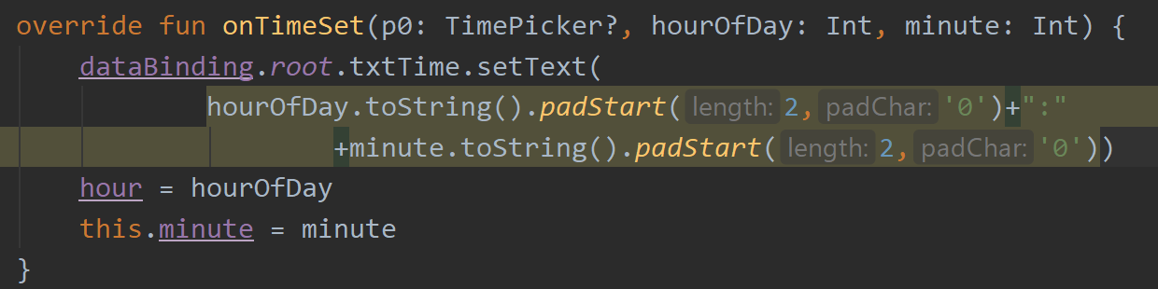
Handle Picker Result
Add following codes into onTimeSet

Slide 76
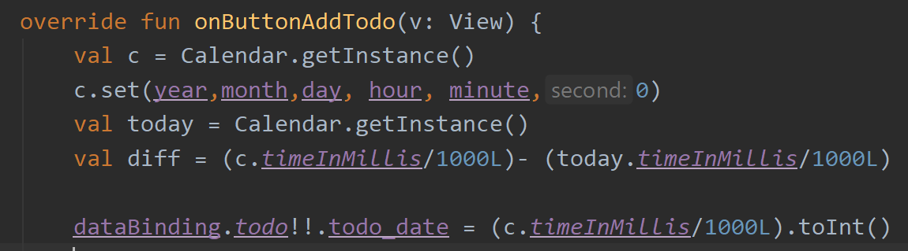
Calculate Delay
Convert to Unix Timestamp
timeInMillis will return selected date into millisecond. Divided by 1000 to convert it into seconds

Slide 77
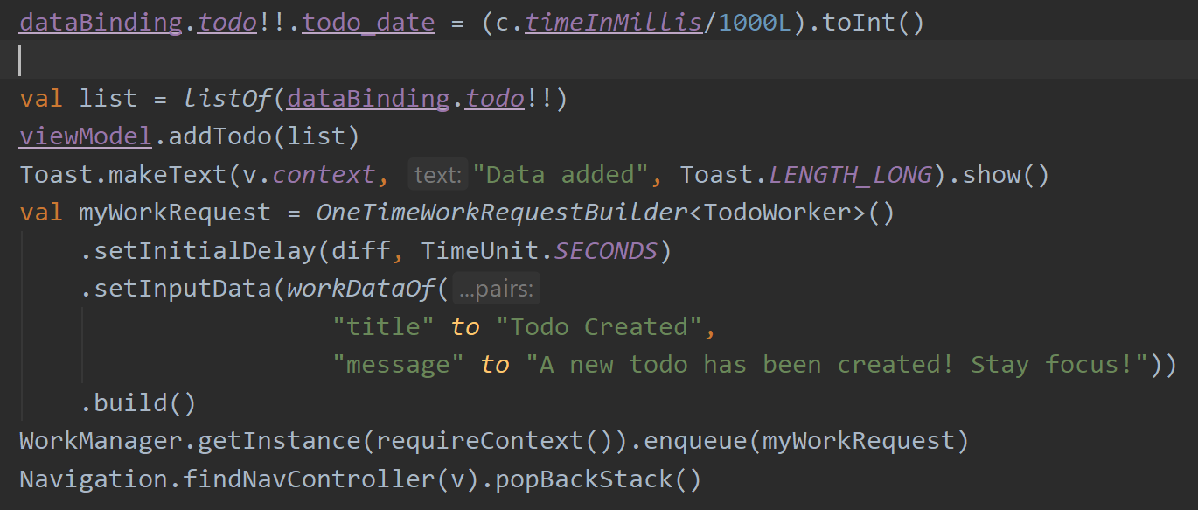
Trigger The Notification Delay

Slide 78
Run The Project
Create a new todo. Set date as the same as today date. Set time ahead 1 or 2 minutes from now. Close the app. Wait for the notification.
Do you see it?

Slide 79
Thanks!
Any questions?
You can find me at
andre@staff.ubaya.ac.id

Slide 80
Credits
Special thanks to all the people who made and released these awesome resources for free:
Presentation template by SlidesCarnival
Photographs by Unsplash

